Slide 1

Group 3 Graph Redesign
STAT 515 - 006
08 March 2022

Slide 2
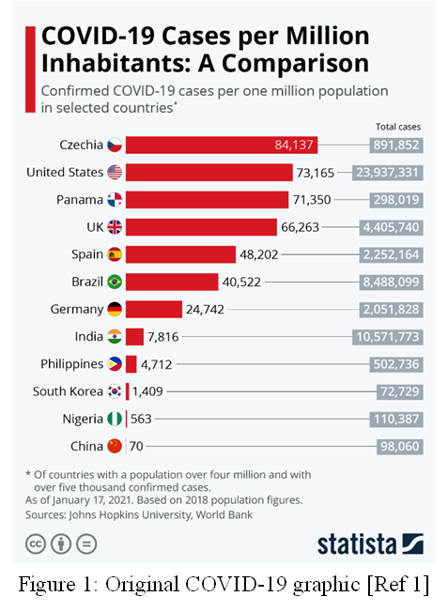
Chosen Graphic
How could this graphic be better?
Select Countries
Only One Date Shown
No Geographical Comparison
Lists Total Cases (no visual comparison)
Buchholz, Katharina. “COVID-19 Cases per Million Inhabitants: A Comparison.” Statista.com, 18 Jan. 2021. Accessed 6 Mar. 2022.

Slide 3
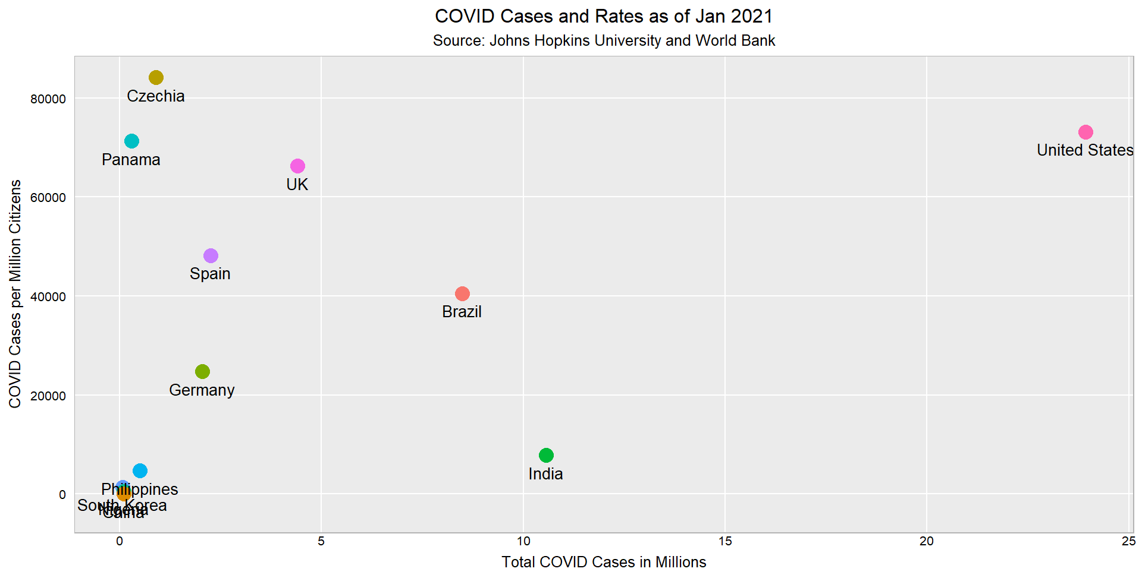
Represented as a Scatter Plot

Slide 4
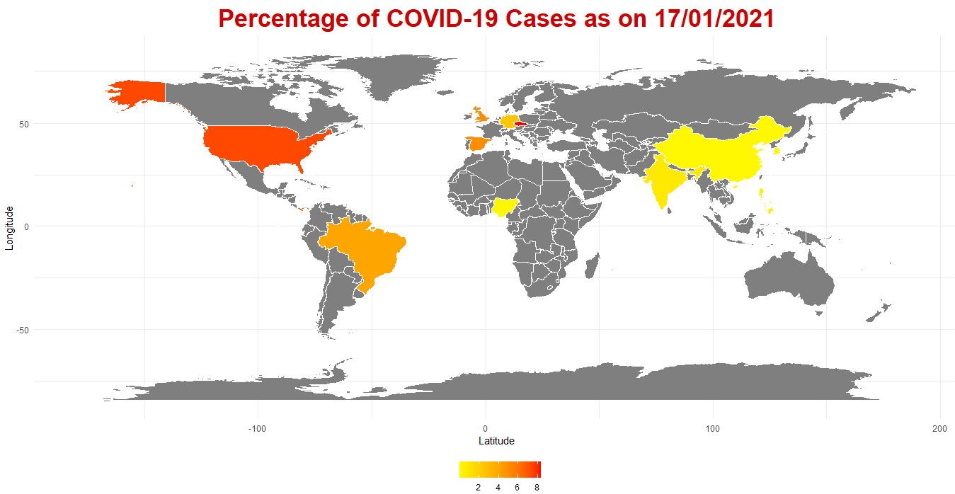
Represented on a Map

Slide 5
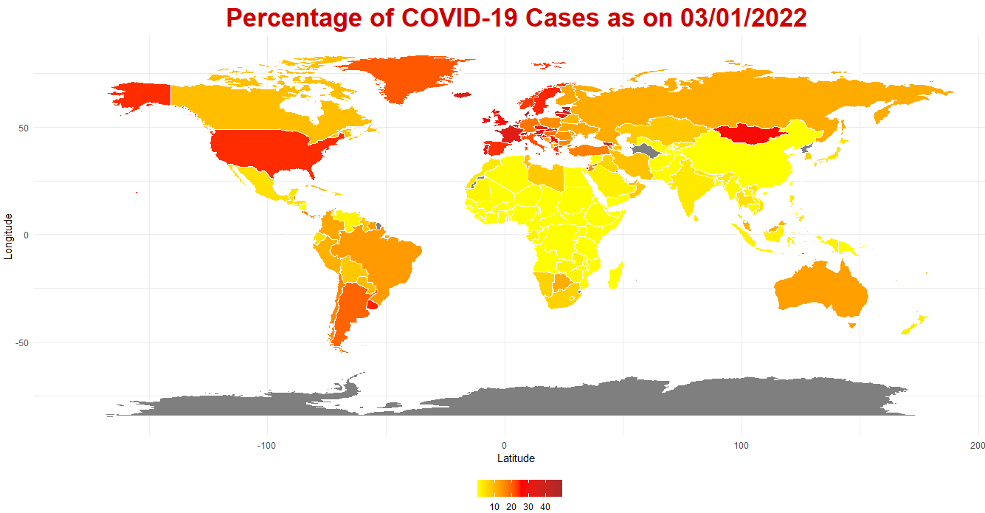
Represented Worldwide Data on Map

Slide 6
Representation as a Line Graph
Graph shows how the total COVID cases change over time.

Slide 7
Representation as a Line Graph (cont…)
Representing infection rate over the same duration.

Slide 8
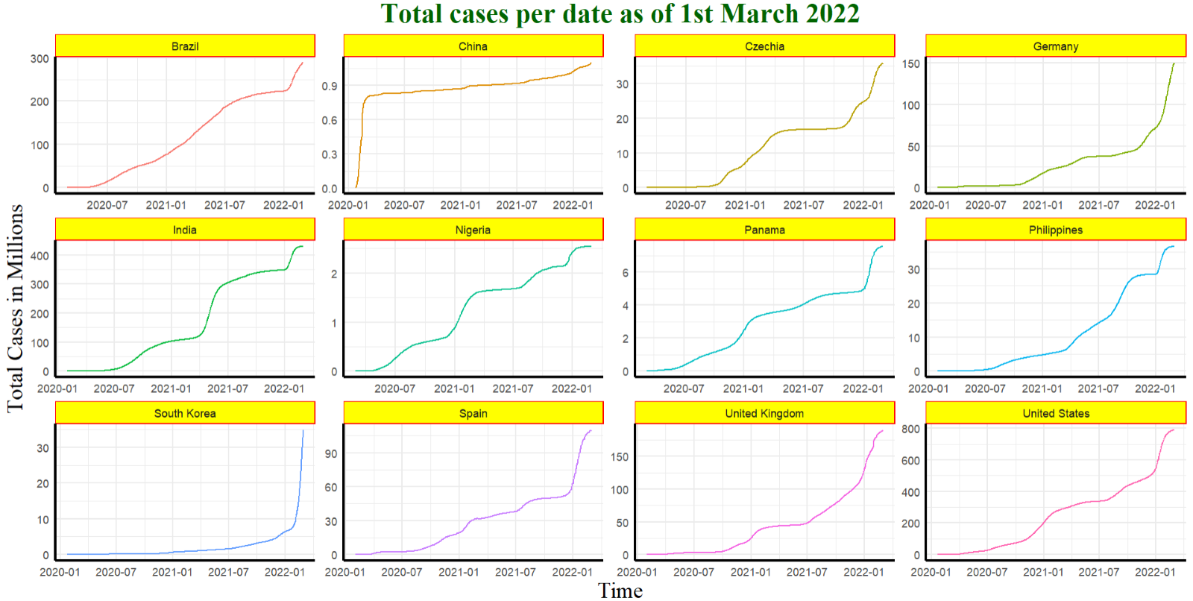
Country wise representation of Total Cases

Slide 9
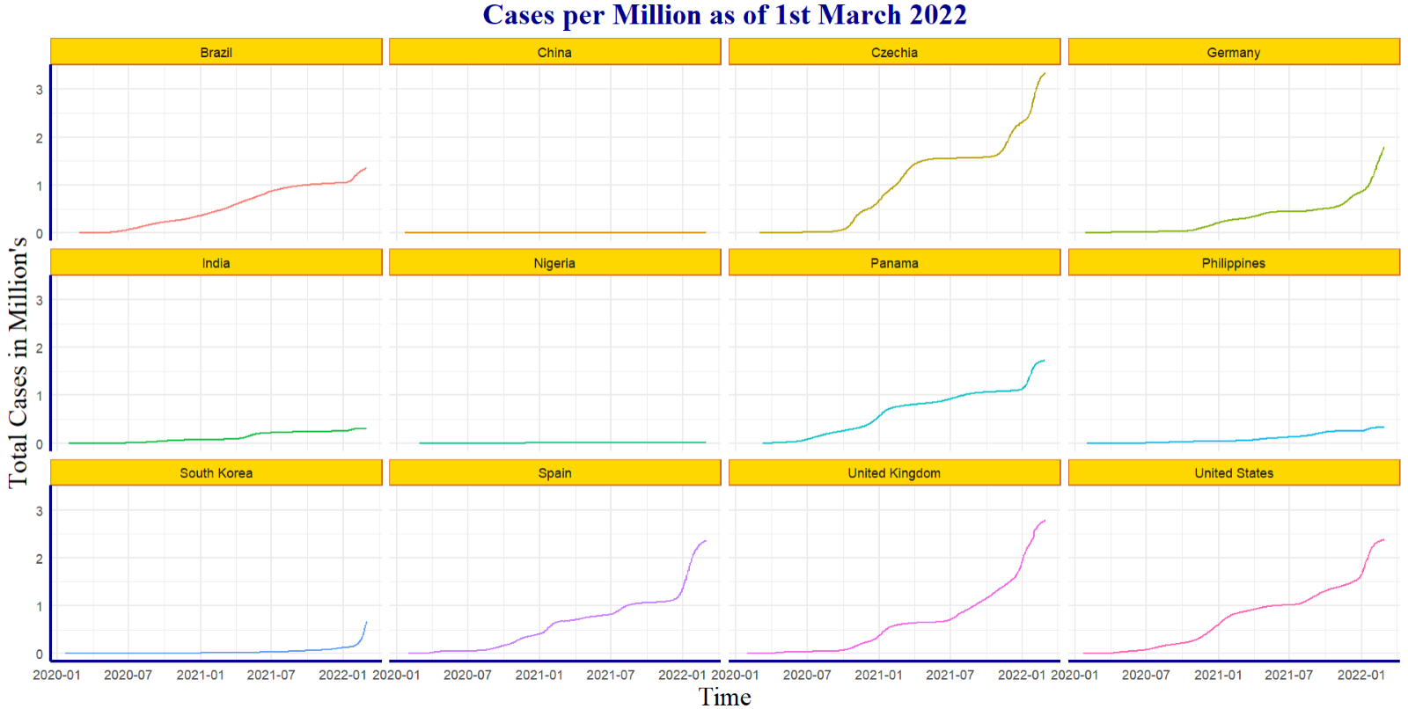
Country specific graph of cases per million citizen's

Slide 10
Time Varying Scatter Plot
Shows how Total COVID cases and infection rate change over time.
Illustrates certain strands such as Omicron which wouldn’t be seen in the original graphic.

Slide 11
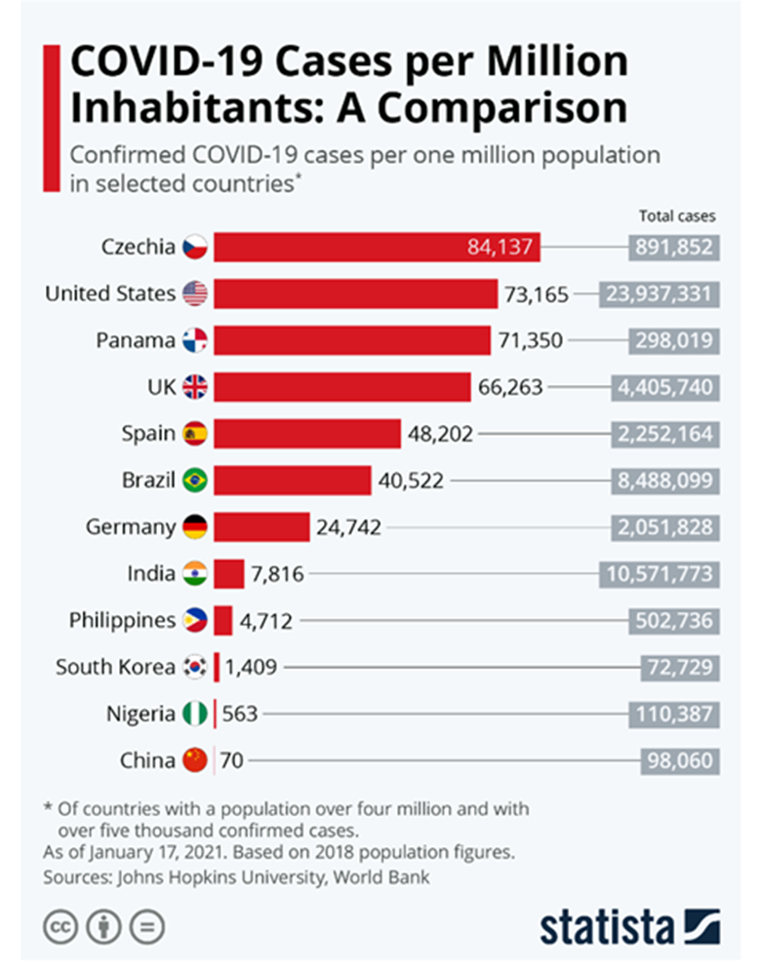
Summary
Added Information for Context:
Geographic Representation
Time Varying Measures
Animations
Multifarious Graphic Styles:
Scatter Plots
Line Plot ~faceted
Animated Line Plots
Animated Scatter Plots
Geographic Mapping

